Slide 1

Paging Part I
Steps:
Select slide show option
Click on Replay
OR
Click on speaker at the bottom right corner of the slide

Slide 2
Paging
Logical Address Physical Address
Page Table Primary Memory Secondary Memory
Page
p | d
f | d
CPU
Frame
.
f
.
.

Slide 3
Paging
Physical address space of a process can be noncontiguous; process is allocated physical memory whenever the latter is available
Avoids external fragmentation
Avoids problem of varying sized memory chunks
Divide physical memory into fixed-sized blocks called frames
Divide logical memory into blocks of same size called pages
Page size=frame size
Keep track of all free frames
To run a program of size N pages, need to find N free frames and load program
Set up a page table to translate logical to physical addresses

Slide 4
Backing store likewise split into pages
Still have Internal fragmentation

Slide 5
Address Translation Scheme
Address generated by CPU is divided into:
Page number (p) – used as an index into a page table which contains base address of each page in physical memory
Page offset (d) – combined with base address to define the physical memory address that is sent to the memory unit
For given logical address space 2^{m} and page size 2^{n}

Slide 6
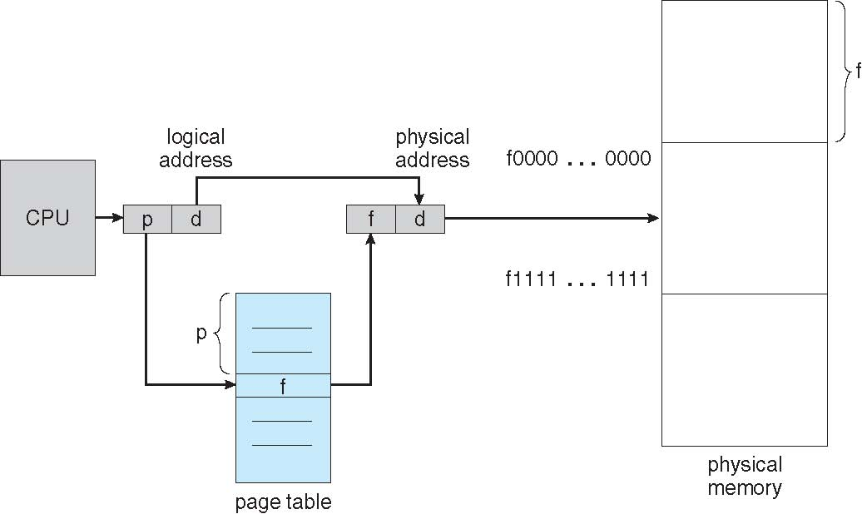
Paging Hardware

Slide 7

Paging Model of Logical and Physical Memory

Slide 8

Paging Example
Logical address to physical address.
Logical address 3
(page 0, offset 3)
maps to physical address 23
=frame number x page size +Offset =(5×4) + 3.
2. Logical address 4 maps to physical address 24 [= (6 × 4) + 0].
Calculate physical address:
Logical address 10
Logical address 0
Instruction ‘m’
n=2 and m=4 32-byte memory and 4-byte pages

Slide 9
Paging (Cont.)
No external fragmentation.
Calculating internal fragmentation
Page size = 20 bytes
Process size = 61 bytes
3 pages + 1 byte
Internal fragmentation of 20 - 1 = 19 bytes
Worst case fragmentation = 1 frame – 1 byte
On average fragmentation = 1 / 2 frame size
So small frame sizes desirable?
But each page table entry takes memory to track
Page sizes growing over time
Solaris supports two page sizes – 8 KB and 4 MB

Slide 10

Free Frames
Before allocation
After allocation

